Slide 1
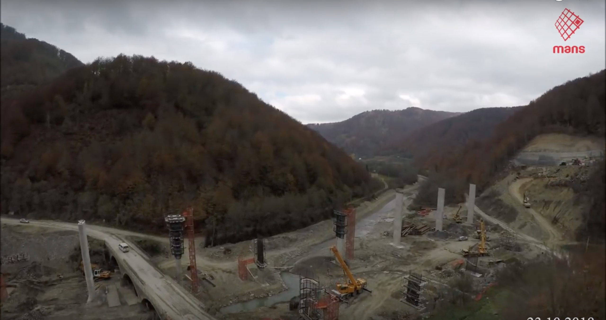
THE BEST&TRANSPARENT MONITORING PROCEDURES FOR ROAD PROJECTS
MsC Maja Čolović-Daul, Dekonta, a.s.

Slide 2
Subjects covered by the presentation
1
Introduction
Infrastructure and EIA
2
EMP
General principles
3
Public inclusion
Transparency

Slide 3
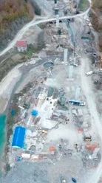
INTRODUCTION
PLANING THE IMPACT MINIMISATION
Environmental Impact Assessment
Environmental Impact Mitigation Plan
Environmental Monitoring Plan
Identify constraints – sensitivity of location, habitats, wildlife, population
Suggest measures – during planning and designing, construction and operation – including closure
Suggest monitoring plan – all mitigation measures
PLAN SHOULD CONTAIN COMPENSATION MEASURES AS WELL

Slide 4
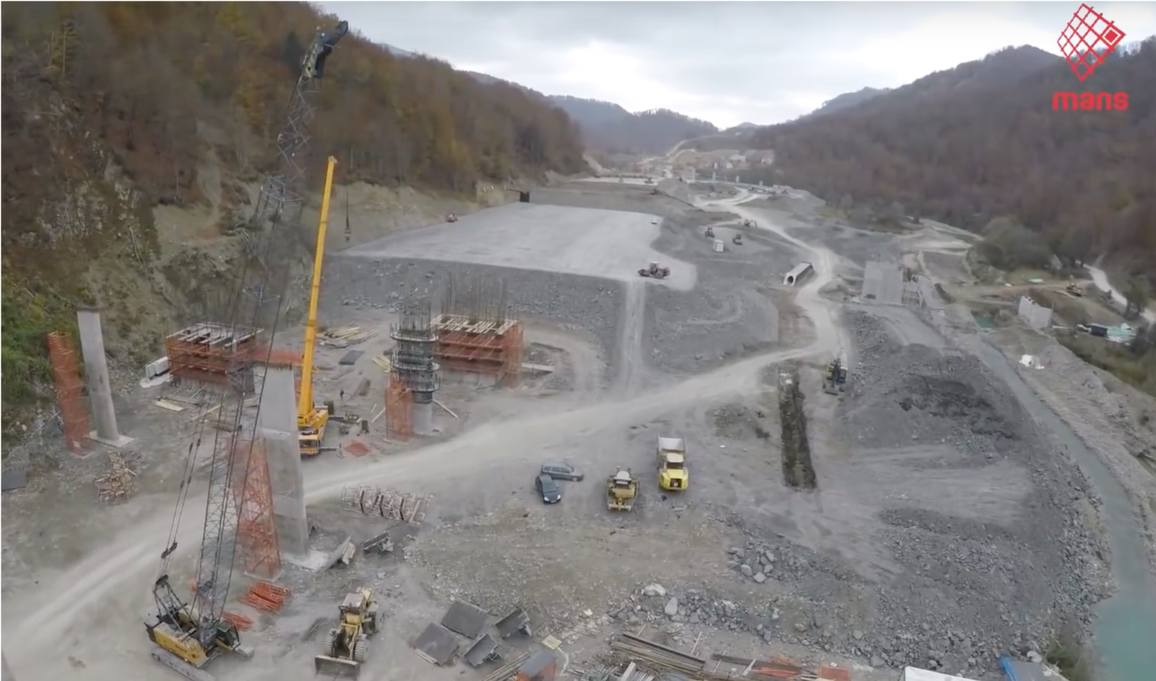
Goal of monitoring plans
Prevention
All impacts that can be prevented by careful planning and design – detail info on sites – EIA – MUST BE PREVENTED
MEASURES ARE SET
Minimization measures
Inevitable impacts, temporary impacts, minimization of impacts – if carefully assessed all potential situations, measures are plan how to mitigate impact
Compensation measures
Mitigation of the environmental impact is not compensation!!
Compensation is applied where the damaged natural resources and/or services do not return to their baseline condition
Notes:
Waste management plan is not sufficient;

Slide 5
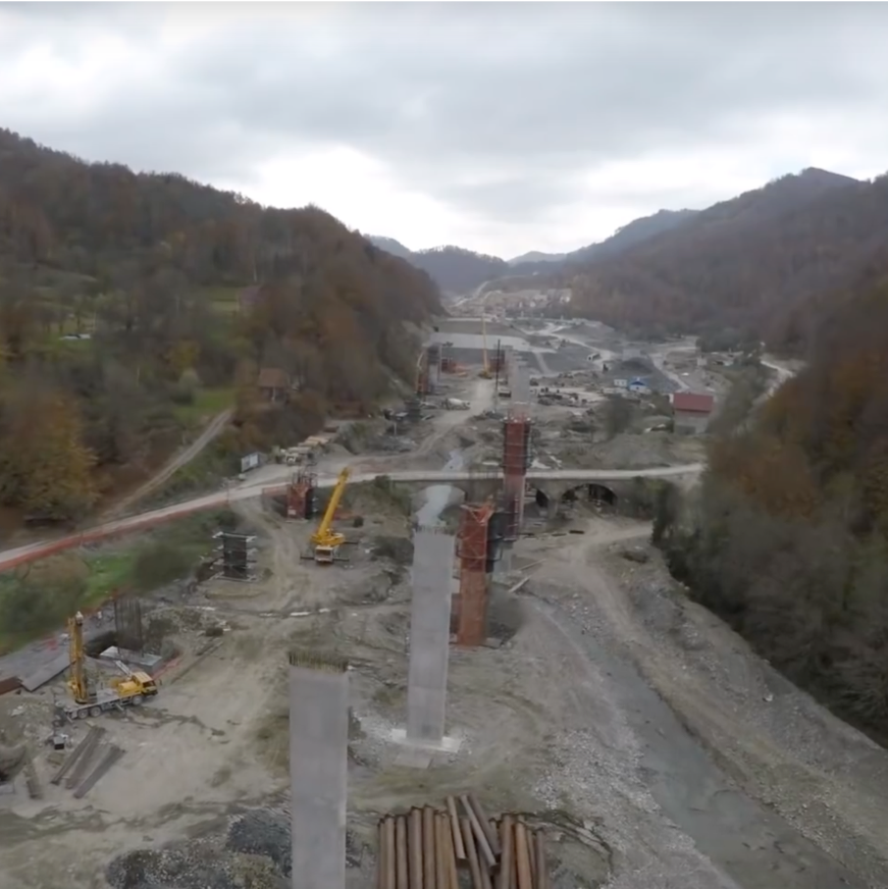
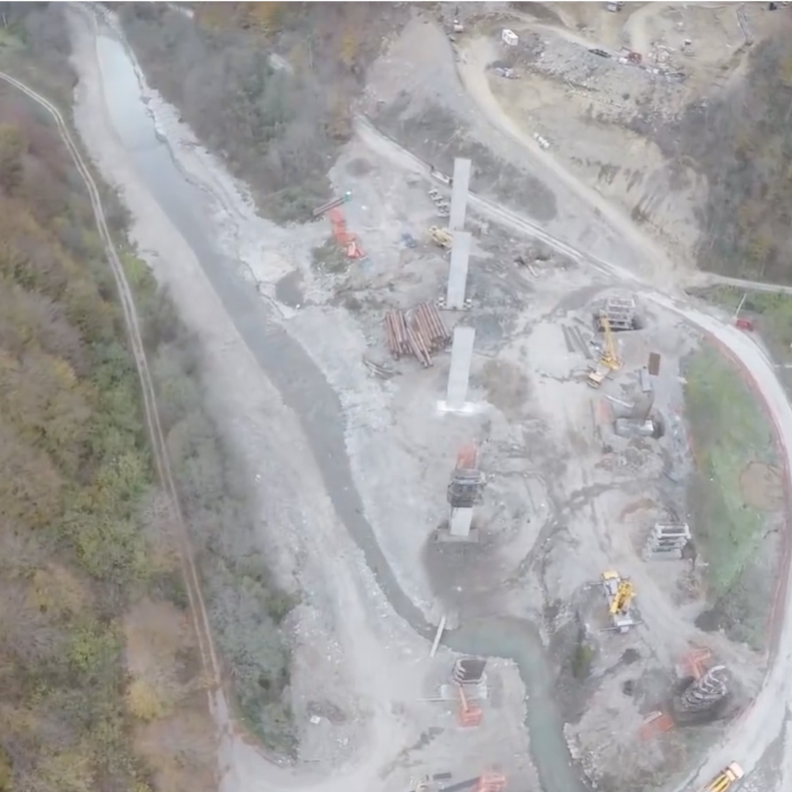
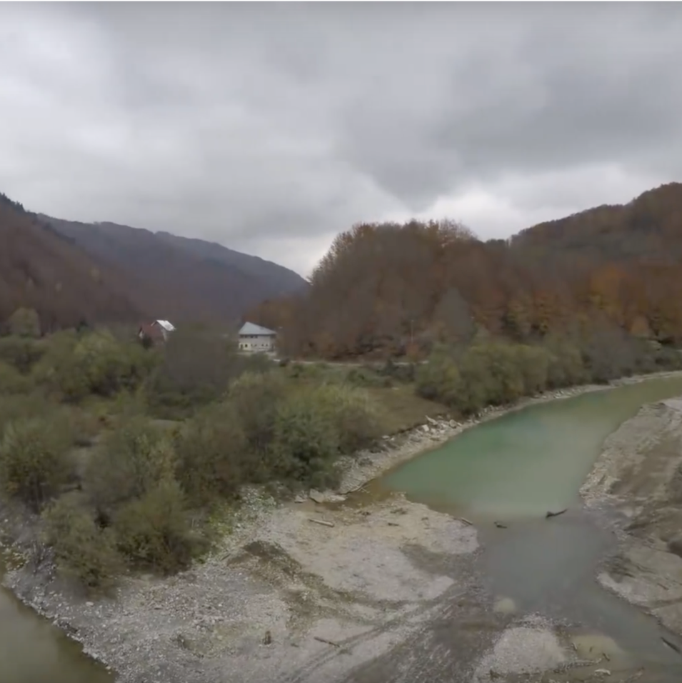
Key monitoring points – road construction
Most frequent mitigation and monitoring issues
Construction material and waste locations
Machinery maneuvering
Temporary storage of material and disposal of constructed waste creates burdens to the environment – compacted soil, unusable soil – huge areas
Additional temporary use of soil; Noise, vibrations, spills, mobile toilets; Maintenance
Sensitive habitats
Protected areas
Including the natural sites and wildlife site; high biodiversity sites; rivers and riverbanks; endangered species sites; forests; BUT also population oriented - livelihood
Water protected zones; natural parks – protected areas; agricultural soil; cumulative impacts!
Notes:
Split on the type of activities and location of activities (sensitivity of locations)

Slide 6
Biodiversity offsetting and restoration
1st pillar
Bedrock of EU nature conservation law
conserve or restore the threatened and endangered habitats and species (listed in Annexes I and II) - ecological network of protected areas
1st pillar
Article 6
In case of sensitive and protected areas – Habitat directive – EU nature directives
Mitigation
Specific procedures to be followed in respect to a plan or project - “appropriate assessment-test.” The impact on the site-specific conservation objectives will be determinative
Article 12 and 16
a strict protection regime for threatened species (annex IV)
Notes:
The Business and Biodiversity Programme (BBOP) of the IUCN now defines biodiversity offsets as “measurable conservation outcomes resulting from actions designed to compensate for significant residual adverse biodiversity impacts
Even the European Commission herself, when issuing opinions under the derogation clause of Article 6(4) for large infrastructure projects, does not always observe the strict derogation conditions. In some cases, economic factors are still superseding a strict assessment of the purported compensatory measures

Slide 7
EU nature directive
Compensation
Mitigation
mitigation measures “are aimed at minimizing or even cancelling the negative impact of a plan or project, during or after its completion”
Compensation
compensatory measures, are independent of the project and aim to offset the negative effects of the plan or project so that the overall coherence of the Natura 2000 network is maintained
Not only traditional measures
Traditional avoidance measures, such as the relocation of a road trajectory, often do not suffice to reconcile development with the EU nature protection rules
Notes:
In other words, although mitigation measures are always on-site and functionally linked to the affected site, compensation, at least within the context of the EU nature directives, aims to generate additional environmental gains on other locations, but not necessarily in a different Natura 2000 site.

Slide 8
Who is responsible to implement and follow the EMP?
Investor
Responsibility of documentation preparation – corporate responsibility, can be transferred to Contractor – but measures need to be requested
1
Contractor-constructor
Who checks?
2
Part of the tendering procedures; need to have envt experts on site; archive daily information; workers to be acquainted with the Plan; Plan has to be on site!
3
Authority
Inspection; authority that issued environmental permit; reporting to investor (can be specific investor request)

Slide 9
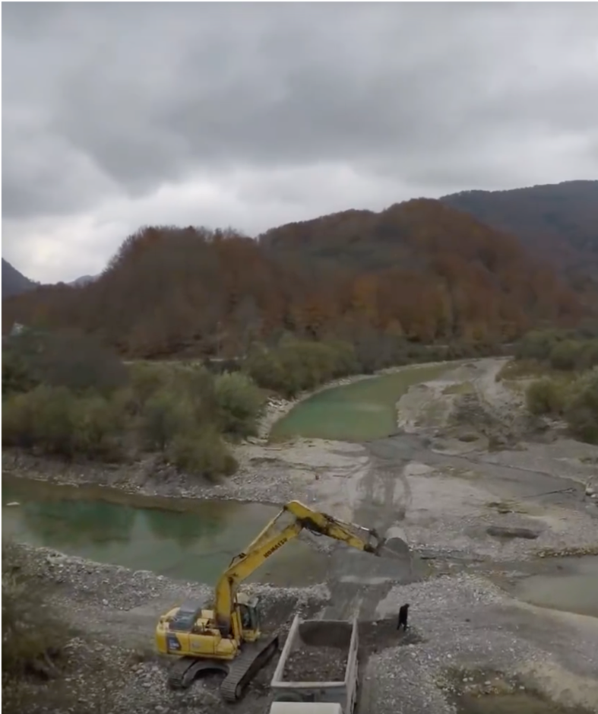
Monitoring of environmental mitigation and minimization measures
Goal
Monitoring should not be used as a general means of gathering information; rather it is a means of monitoring, where appropriate, any mitigating measures identified through the EIA process.
Changes in approach - Planning
Not as identification of measures to be undertaken, but evaluation of the measures effectiveness
Construction and operation
Monitoring to measure effectiveness of mitigation
monitoring where there is a high risk of challenge, technical standards / background conditions may change or nearby vulnerable receptors
Notes:
Source: www.gov.uk/guidance/environmental-impact-assessment#decision-making-subject-to-EIA

Slide 10
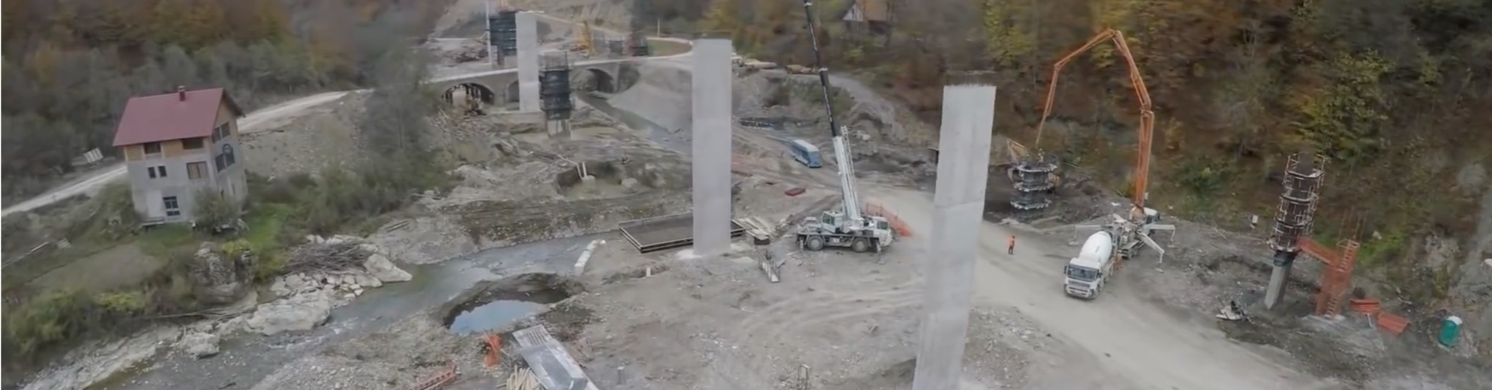
What to monitor
Monitoring refers to a wide range of activities, including:
  SWMP data
  audit reports
  maintaining and reviewing training records
  chemical analysis of discharges and/or baseline levels and nearby streams
  waste transfer or consignment notes
  records of dust generation
  noise monitoring records.

Slide 11
Transparency of monitoring process
Incidents response plan - on-site risks and appropriate responses
Site monitoring; Donor supervisor-missions; Monthly reporting; Grievance mechanism
What?
Who, how?
What to
Monitor?
Incidents
Public
Environmental permit measures
Through grievance mechanism; Environmental Reporting Spreadsheet - - Waste management plan
Activities and permit (disposal sites, etc.) tracker!
Aarhus convention!! (Niksic, Berane, Podgorica)
Population communication plan!
Detailed information pack
Management of Earthworks; Management of Waste; Management of the Water bodies Environment; Management of Material & Resource Consumption; Management of Fuel & Chemicals;
Notes:
Successful environmental management relies on communication. It is crucial that everyone is aware of the key issues, has the relevant information to deal with them, understands their responsibilities, and provides feedback to those in charge.

Slide 12
reCommunicate monitoring with Public
Continuous information of public
3
In case of identified obstructions, problems, bad results – information on undertaken measures need to be carried
Measures
2
Continuous pressure and information sharing – positive and negative statements (activities)
Public
1
Contractor-constructor-investor: all information on environmental monitoring requirements
Info - sites

Slide 13
Post construction monitoring
Reconsiderations on measures!
Does not refer to maintenance, but re-cultivation of sites
Usual problem – compacted soil - vegetation cant be retrieved
Temporary towards permanent impact on the river biodiversity and flow
Additional activites
Monitoring measures

Slide 14
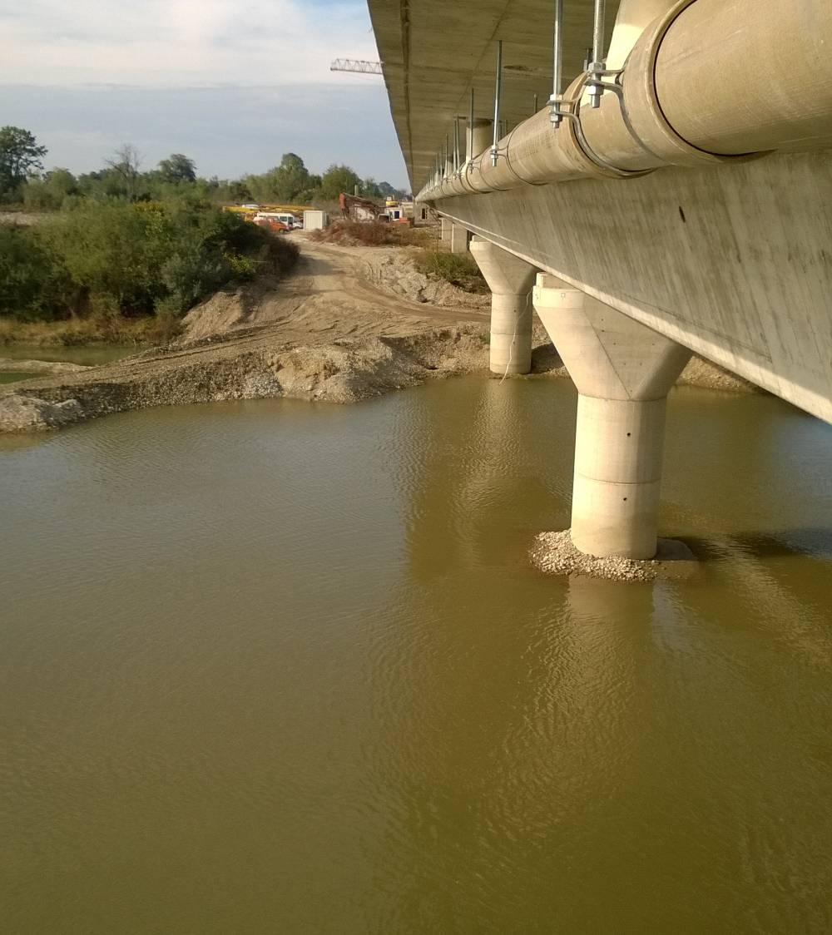
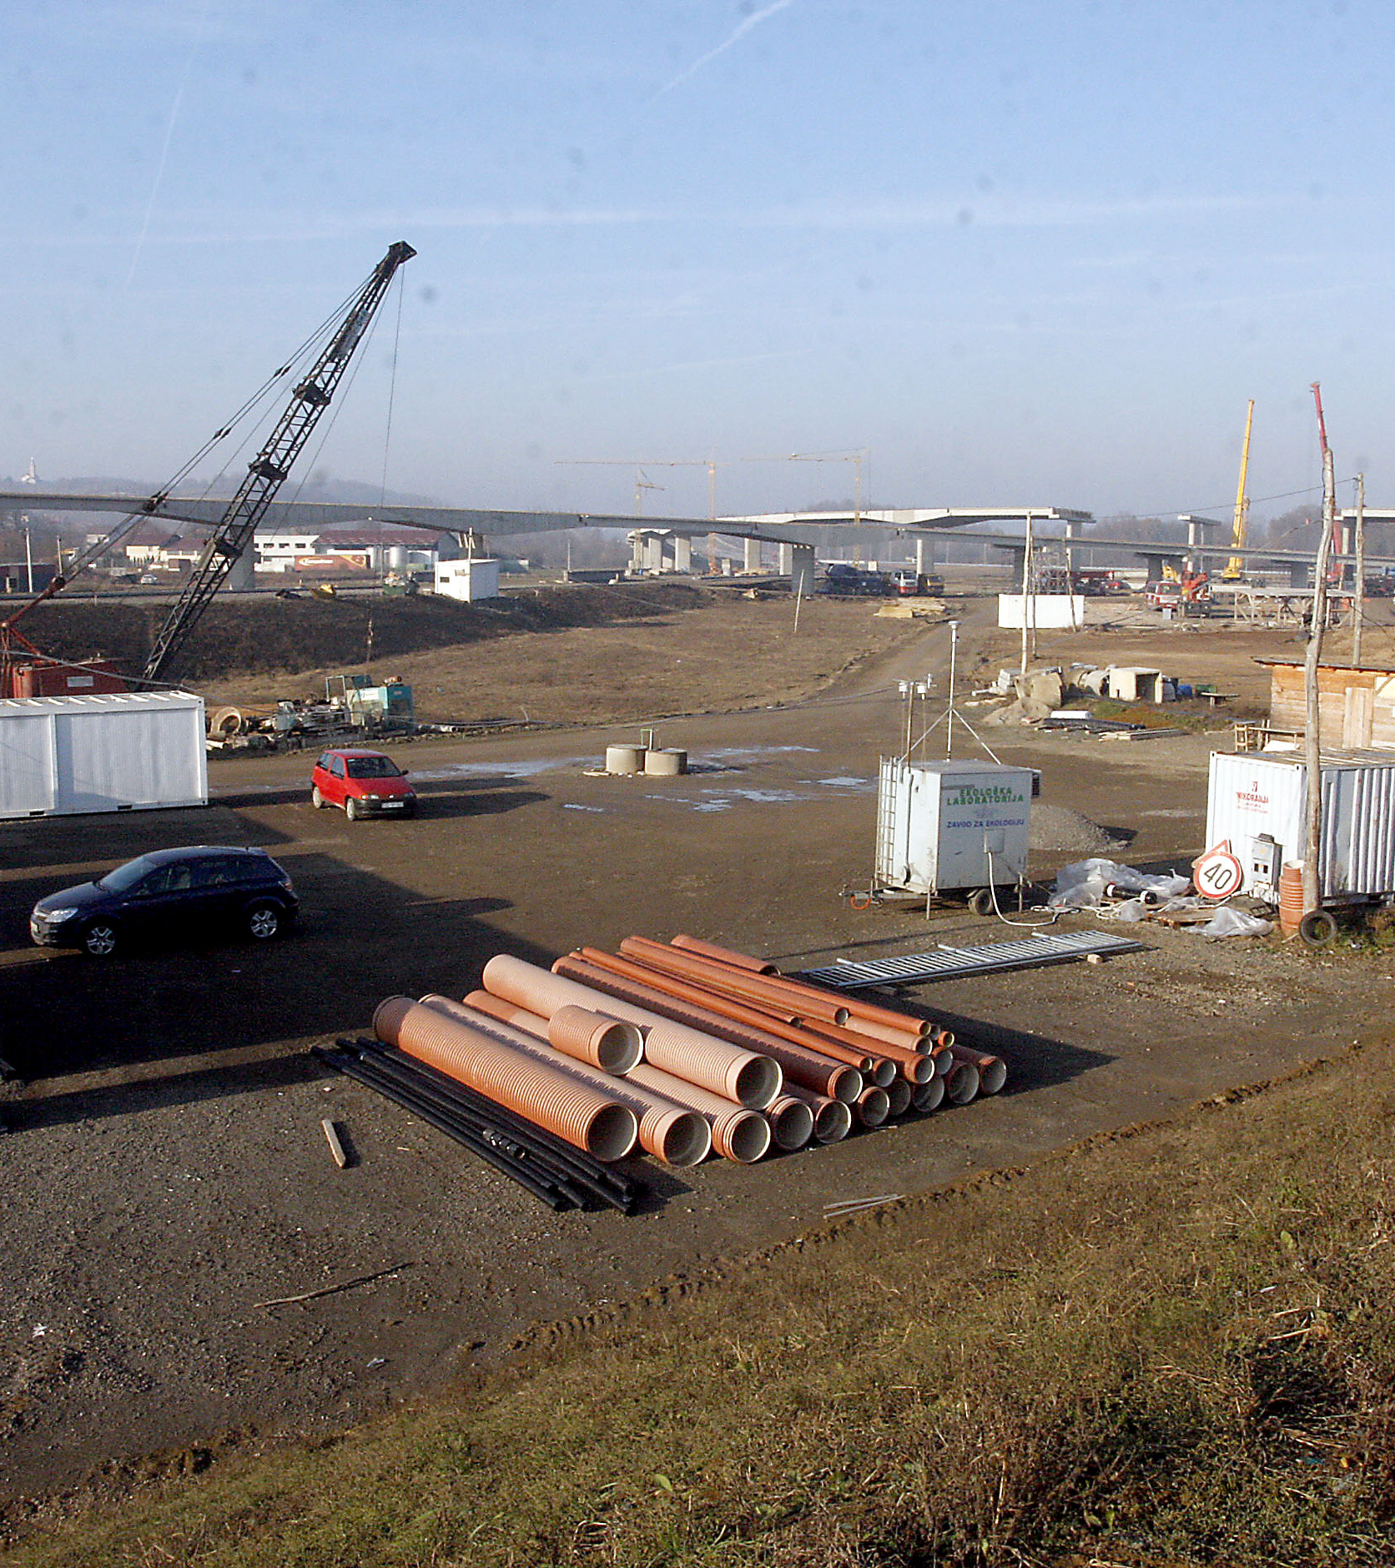
Good monitoring examples
To what needs to be given special attention?

Slide 15
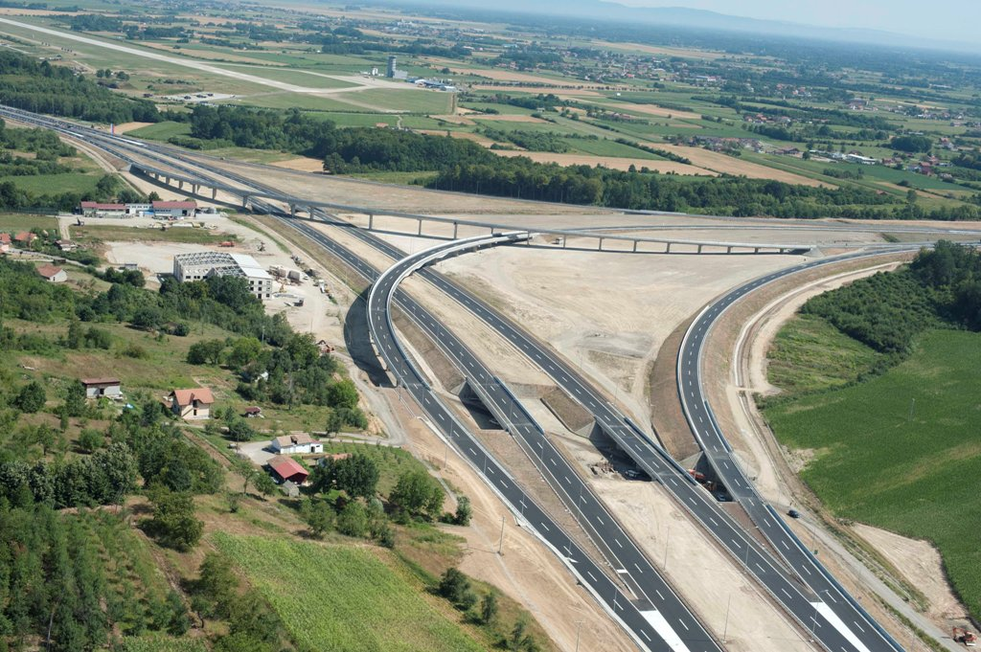
To what to pay attention
Noise
In most case studies, nose was above the permitted levels and baseline state level
Water quality
Usualy these aprameters are above the limits: BOD; COD (organic pollutants); TSS (transportation activities ); A-N (sanitation facilities )
Area - water runoff
When hard surface reaches 30-40% of the area about 30% of precipitation water becomes surface runoff, at 80-90% more than 55% of water becomes runoff. As a result, groundwater supplies may not be fully recharged, streams tend to degrade, and flooding often increases

Slide 16
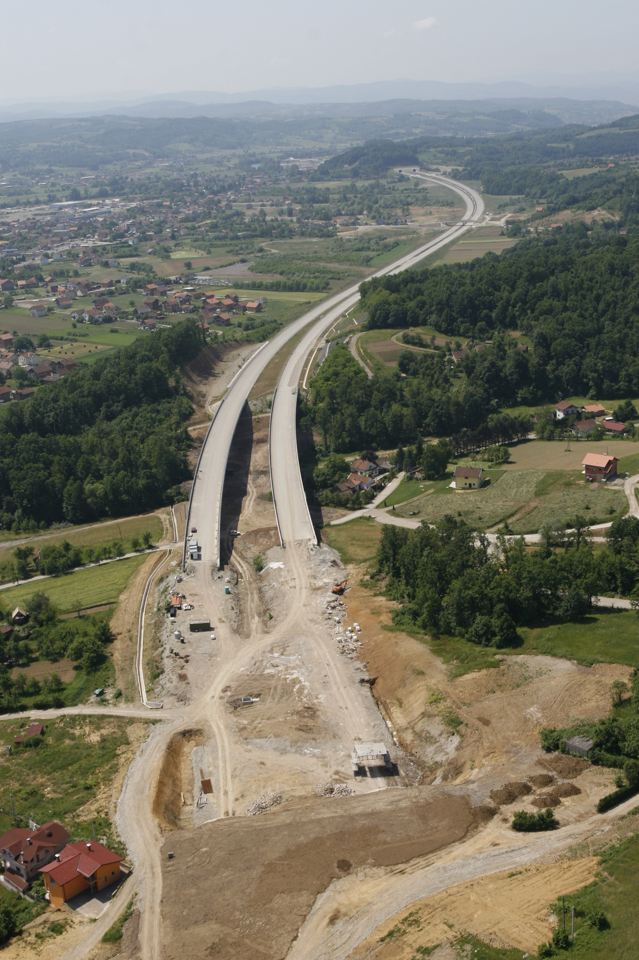
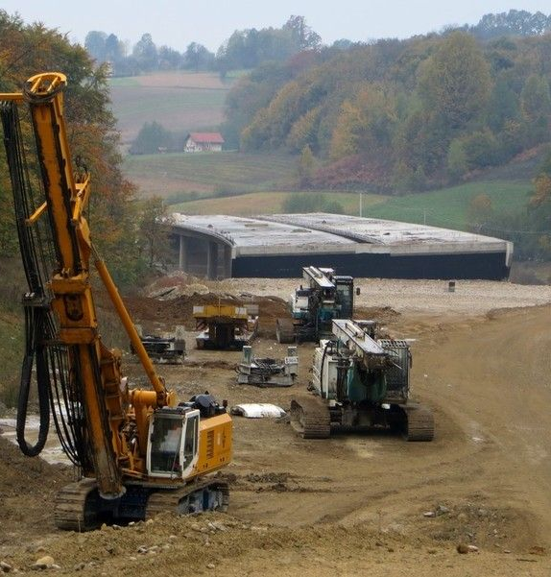
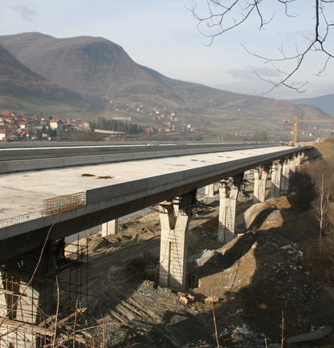
Regional Case studies
Mahovljani road construction; Doboj-Banja Luka highway construction;

Slide 17
Thank you!
Any questions?
Maja Čolović-Daul

